Slide 1
Introduction to VHDL
By- CHANDRAMOULI Haldar

Slide 2
What is VHDL?
VHDL (Very High-Speed Integrated Circuit Hardware Description Language) is a Hardware Description Language (HDL) used to model, design, and simulate digital systems.
It is used for:
FPGA Design
ASIC Design
Simulation of digital circuits
RTL Design
Testbench creation

Slide 3
Why VHDL is used
Describes hardware behavior
Supports simulation before fabrication
Used in industry for ASIC/FPGA
Strongly typed language (more strict than Verilog)
Supports structural, dataflow & behavioral modeling

Slide 4
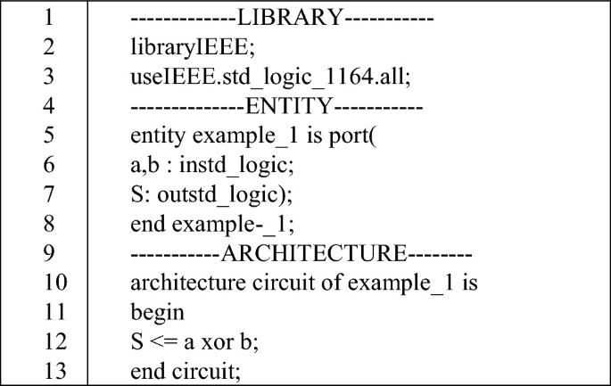
BASIC STRUCTURE OF VHDL
VHDL has two main parts:
Entity → Defines inputs & outputs
Architecture → Defines internal working

Slide 5
Different Modeling Styles in VHDL
Dataflow Modeling
Behavioral Modeling
Structural Modeling

Slide 6
Dataflow Modeling
Uses concurrent signal assignments.
Example (AND Gate):
Y <= A AND B;
Simple
Used for combinational logic

Slide 7
Behavioral Modeling
Uses process block
process(A,B)
begin
if (A='1' and B='1') then
Y <= '1';
else
Y <= '0';
end if;
end process;
Used for complex logic
Uses IF, CASE, LOOP

Slide 8
Structural Modeling
Connecting components like hardware blocks.
component and_gate
Port(A,B: in STD_LOGIC;
Y: out STD_LOGIC);
end component;
Used for hierarchical design
Used in large VLSI systems

Slide 9
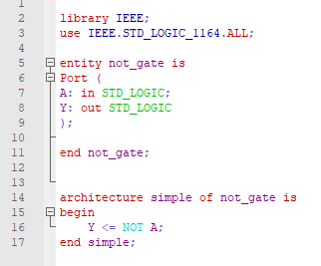
NOT Gate in VHDL
Including Library
Defining Input / Output
Defining Logic

Slide 10
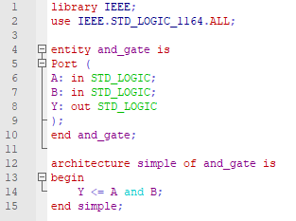
AND Gate

Slide 11
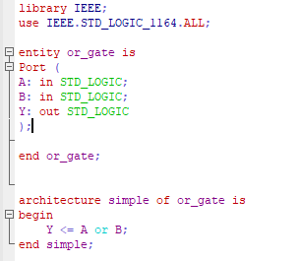
OR Gate

Slide 12
Practice
NAND
NOR
XOR
XNOR

Slide 13
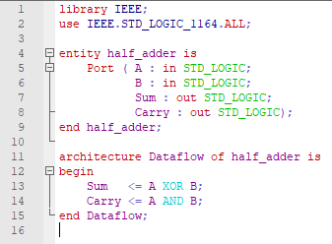
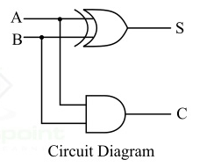
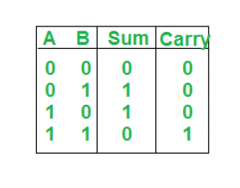
HALF ADDER

Slide 14
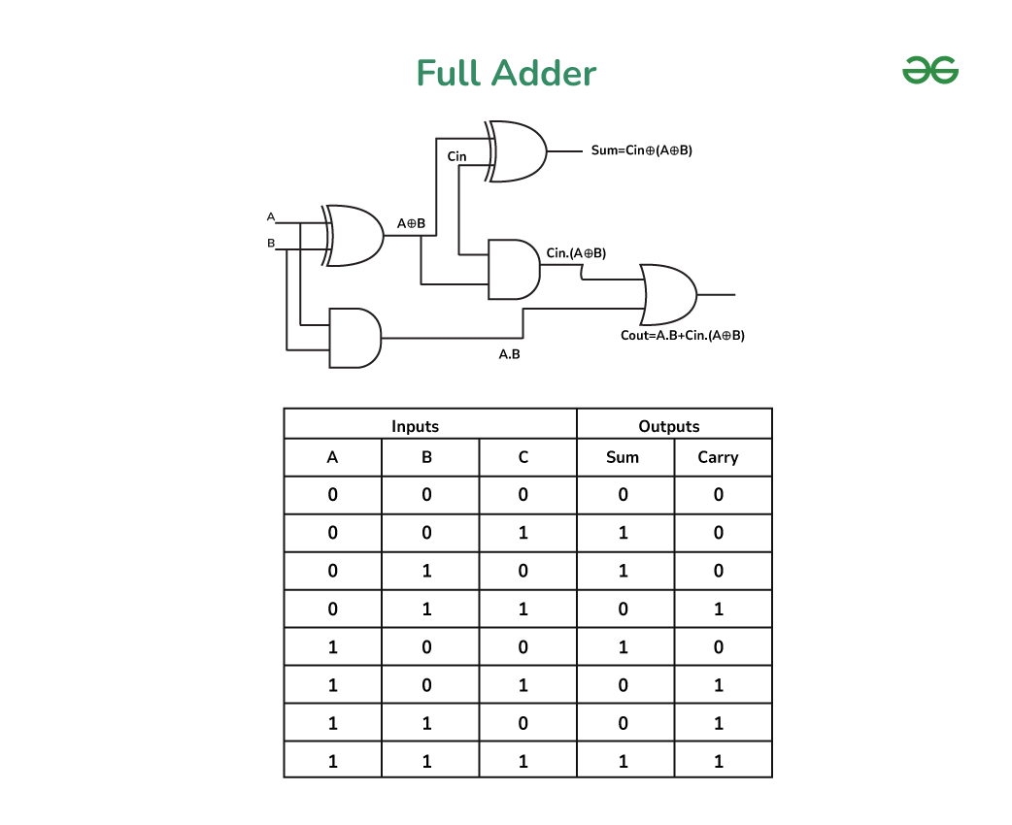

Slide 15
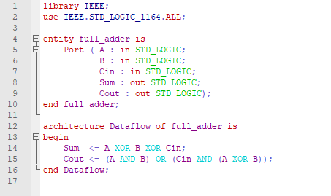
FULL ADDER

Slide 16
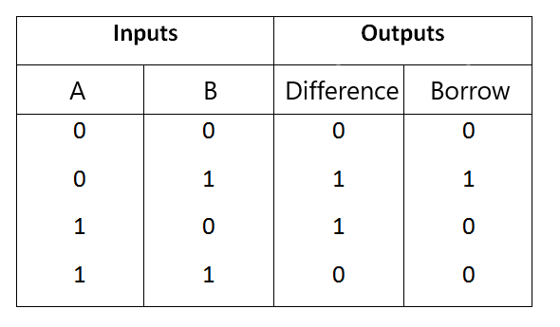
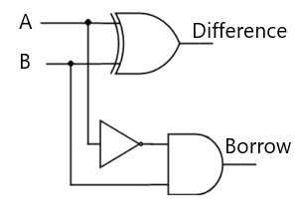
HALF SUBTRACTOR

Slide 17
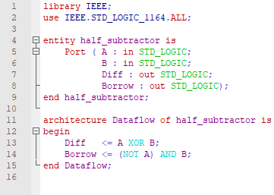
HALF SUBTRACTOR

Slide 18
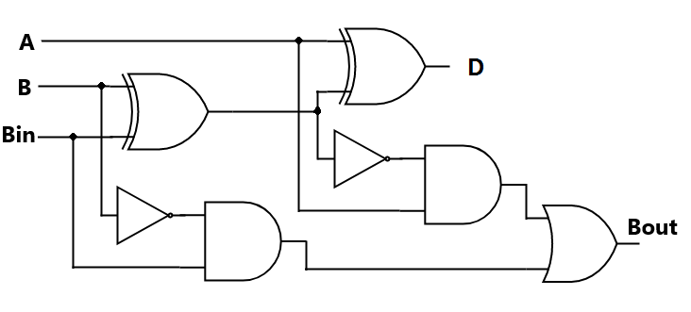
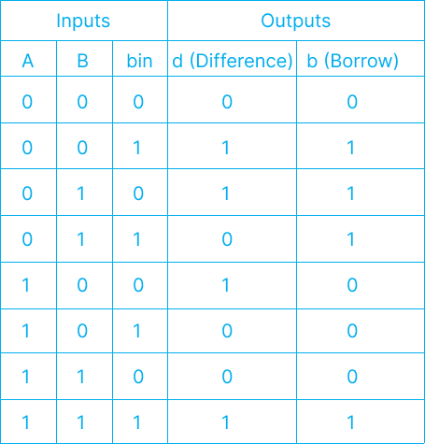
FULL SUBTRACTOR

Slide 19
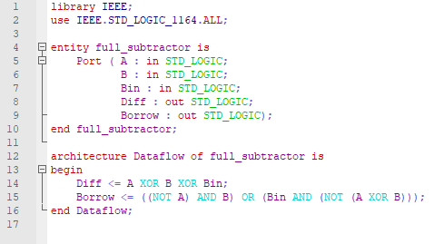
FULL SUBTRACTOR

Slide 20
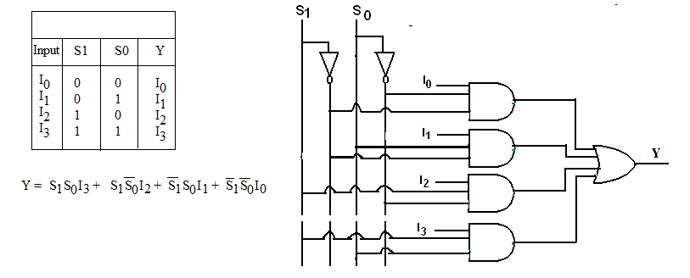
4:1 MULTIPLEXER

Slide 21
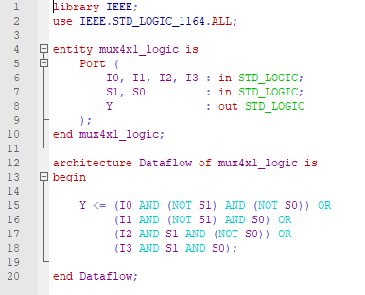
4:1 MULTIPLEXER

Slide 22
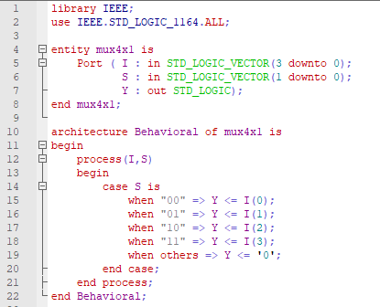
4:1 MULTIPLEXER

Slide 23
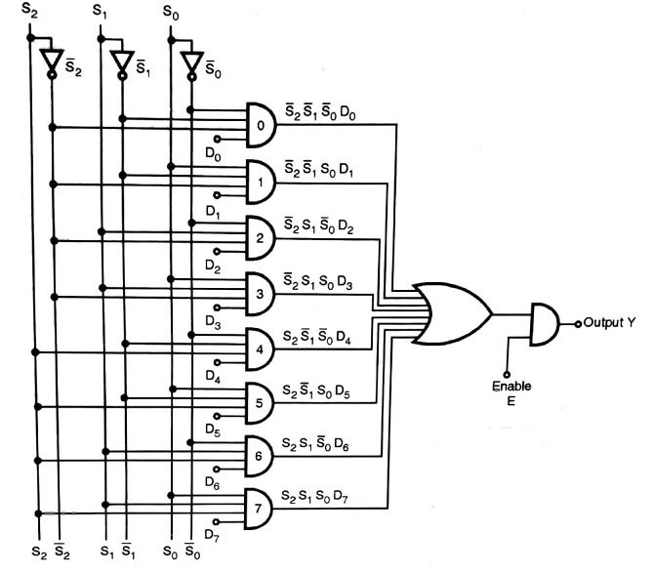
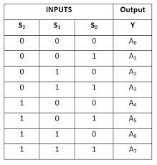
8:1 MULTIPLEXER

Slide 24
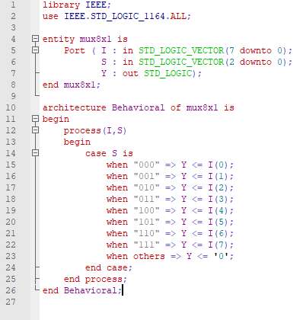
8:1 MULTIPLEXER

Slide 25
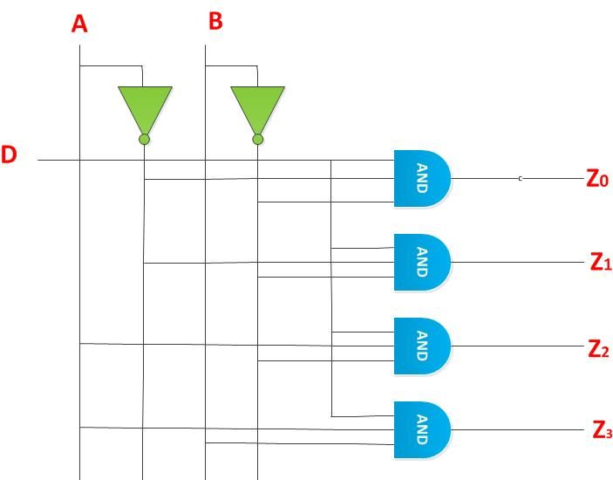
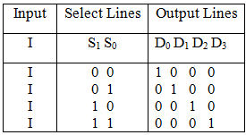
1:4 DEMULTIPLEXER

Slide 26
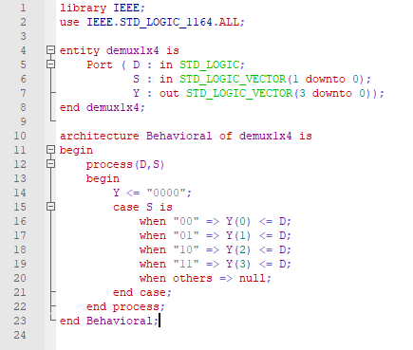
1:4 DEMULTIPLEXER

Slide 27
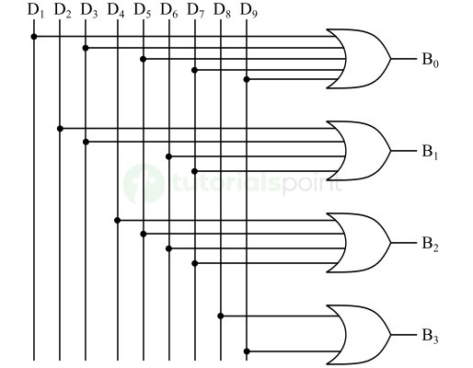
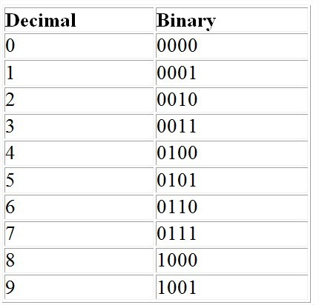
BCD (Decimal 0–9) to Binary Converter

Slide 28
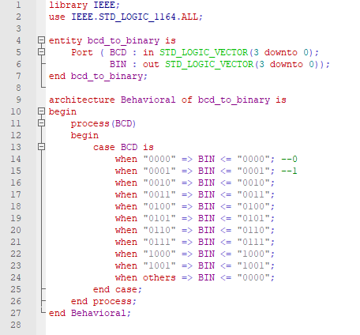
BCD (Decimal 0–9) to Binary Converter

Slide 29
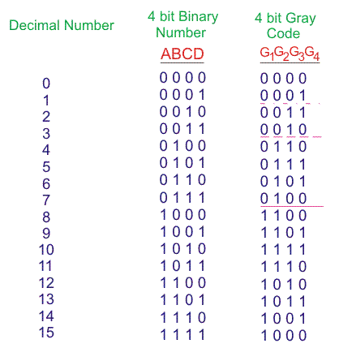
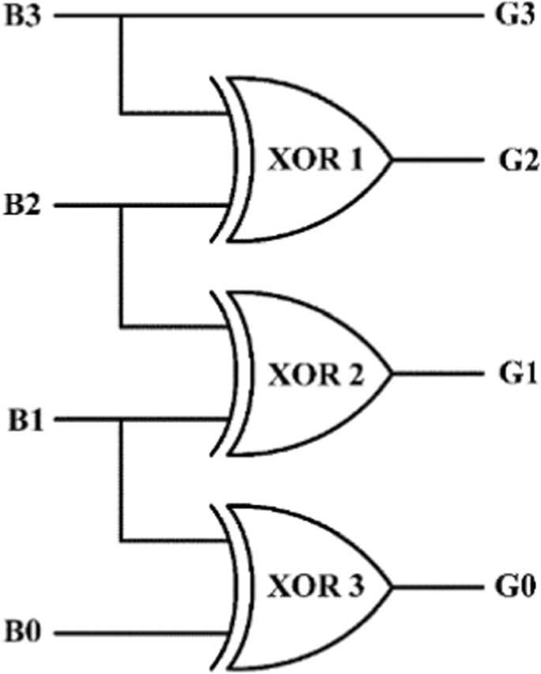
Binary to Gray Code

Slide 30
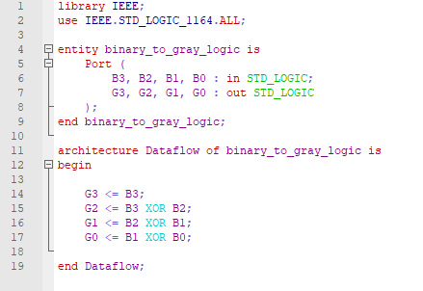
Binary to Gray Code

Slide 31
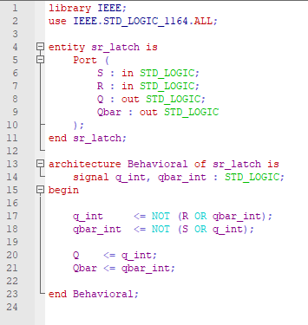
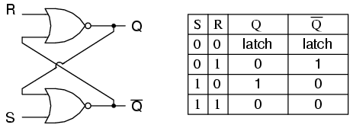
SR Latch

Slide 32
THANK YOU!
The class will end at 1:30, not before that.

